Slide 1
Distribution of Police Stations in the Metropolitan cities of India
Coursera Applied Data Science Capstone Assignment

Slide 2
Introduction
Suppose a person has landed a job in one of the metropolitan cities of India. He wants to shift there and is looking for a safe locality to live. Or a parent’s child is shifting to one of these cities for pursuing his/her studies and they’re concerned about the safety of their child and want to find out how well connected the city’s police network is. Or a person already living in the city needs to know the location of the police station nearest to their home or workplace. For these purposes we will use Foursquare API to make queries and perform some analysis on the data provided to us.

Slide 3
Description of the Data
Being the Metropolitan Cities, there are a lot of educational opportunities, new job vacancies, etc. every year. So a lot of people are attracted to these cities.
We take into account 4 cities- New Delhi, Bangalore, Mumbai and Lucknow.
Therefore, we perform our analysis on these 4 cities.

Slide 4
Methodology
The main target here is to asses which city would have the highest density of Police Stations. I used the Four Square API through the venues channel. I used the explore query to get venues in the cities. Also, I used the CategoryID to set it to show only Police Stations. An Example of my requests is shown below.
https://api.foursquare.com/v2/venues/explore?&client_id=&client_secret=&v=20180605&New Delhi,National Capital Territory, India&limit=100&categoryId=4bf58dd8d48988d12e941735
4bf58dd8d48988d12e941735 is the Foursquare Id of Police Stations. Also, Foursquare limits us to maximum of 100 venues per query. Moreover, I repeated this request for the remaining 3 cities and got their top 100 venues. I saved the name and coordinate data from the result and plotted them on the map for visual inspection.
Next, to get an indicator of the density of Police Stations, I calculated a center coordinate of the venues to get the mean longitude and latitude values. Then I calculated the mean of the Euclidean distance from each venue to the mean coordinates. That was my indicator-mean distance to the mean coordinate (MDMC).

Slide 5
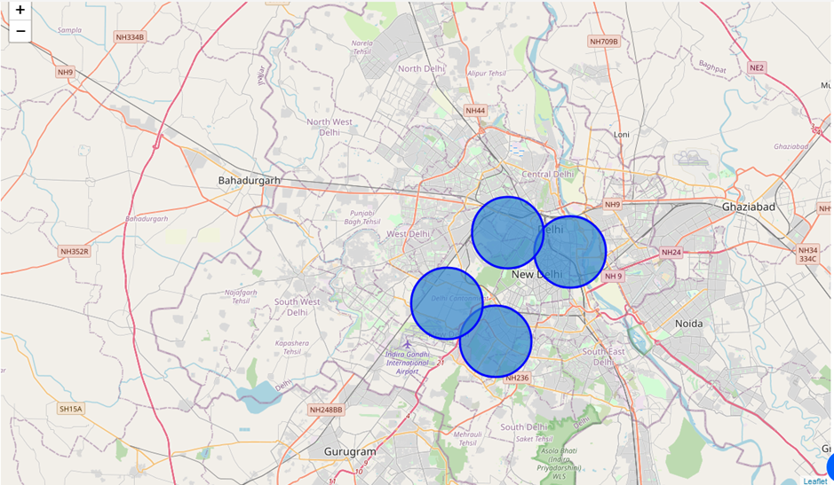
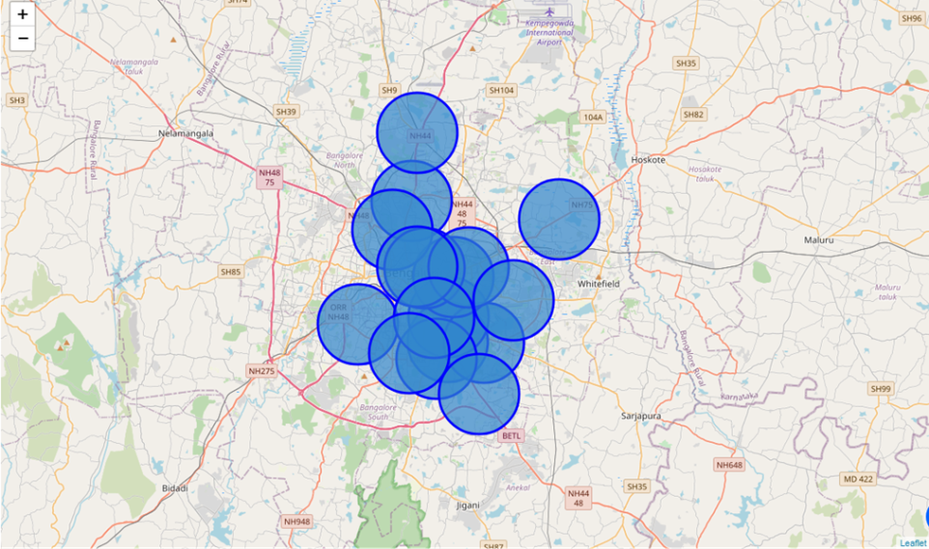
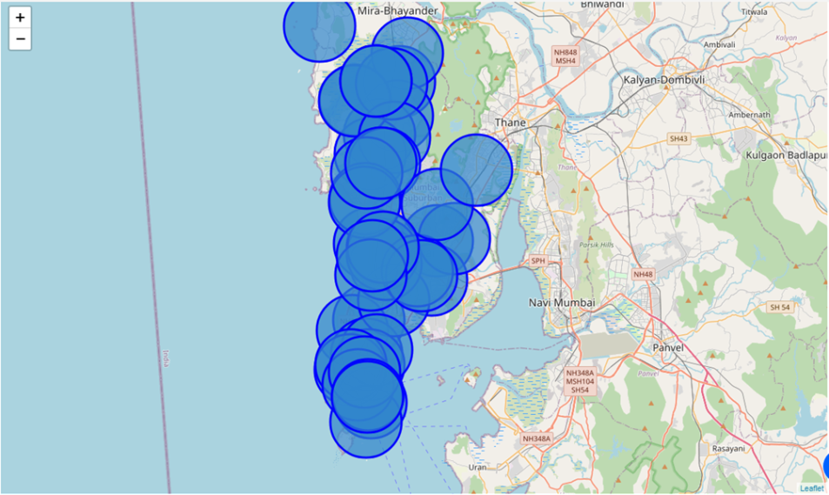
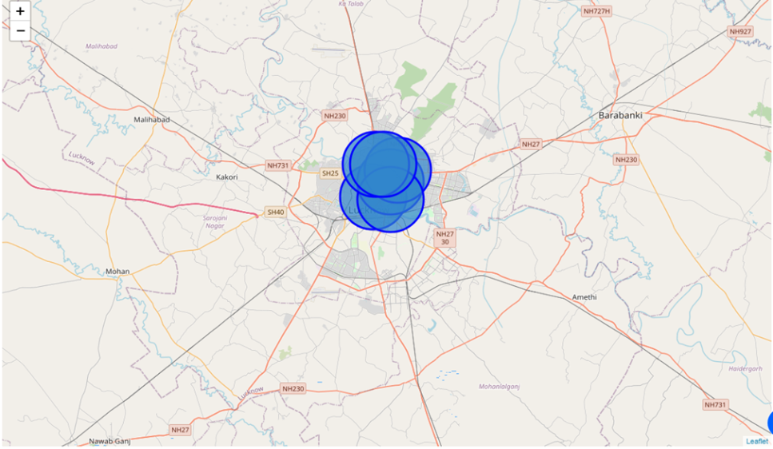
Results
NEW DELHI
BANGALORE
MUMBAI
LUCKNOW

Slide 6
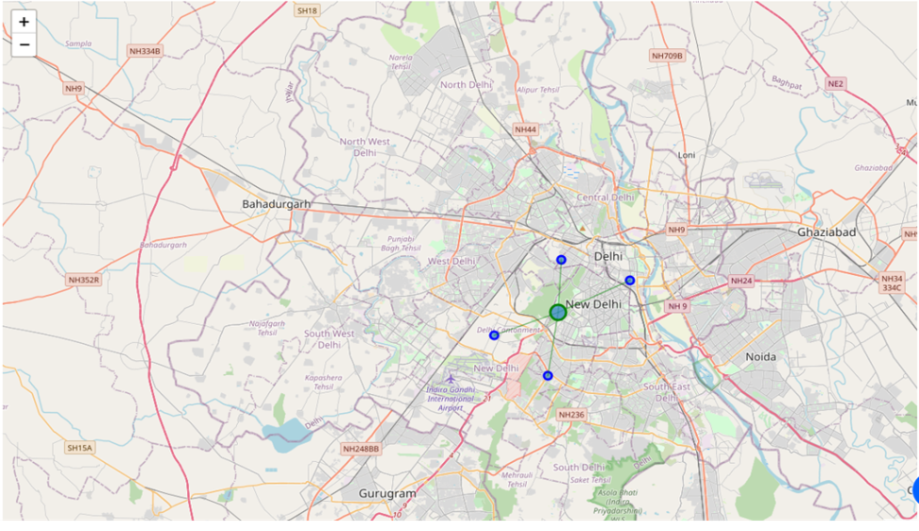
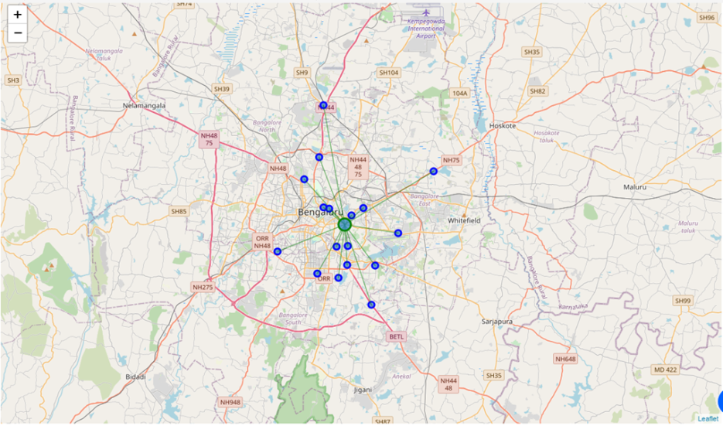
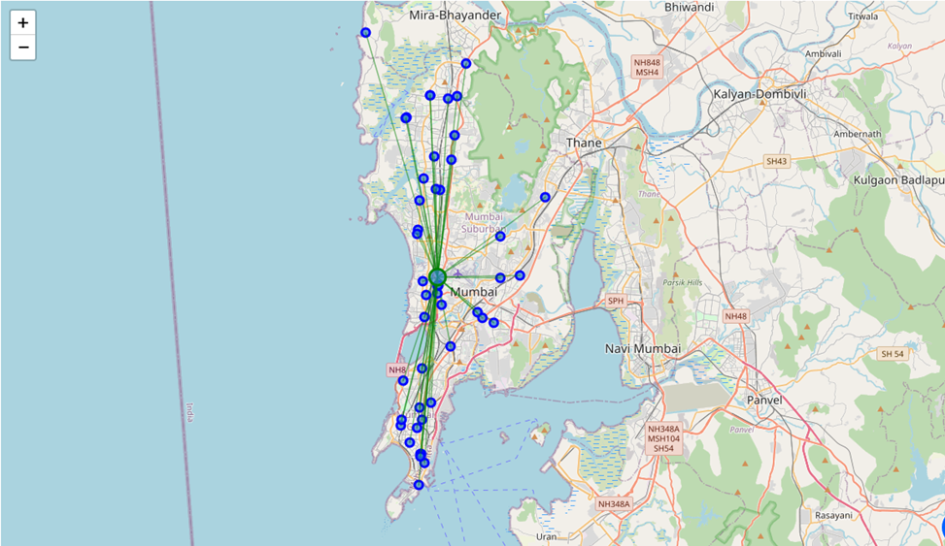
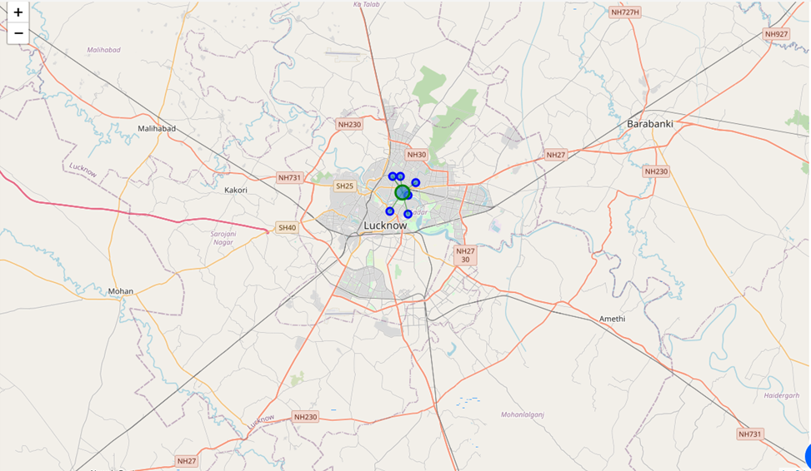
Mean Distance to Mean Coordinate
New Delhi 0.05473523082961468
Bangalore 0.05809142047400903
Mumbai 0.09155085017257628
Lucknow 0.01558841116226777

Slide 7
Conclusion
Upon first inspection, we may conclude that Bangalore and Mumbai are well networked but after calculating the Mean Distance to Mean Coordinate (MDMC) we observe that even though the number of Police Stations in Mumbai is more, Bangalore is still more densely distributed with police stations.
We can hence conclude that in shifting to Bangalore a person can be relatively at ease and feel secure because of the well connected network of police stations there.

